Slide 1
Using Game Theory In Mitigating Covid Spread, and Vaccination
As the emerging of the recent viable covid-19 prevention strategies and vaccinations, the vaccination uptake and Covid protocols for mitigating the spread of coronavirus have become a key factor in eradicating the virus & building immunity. We have discussed that game theory & social etiquette models should be used to guide decisions pertaining to preventing the transmission of the deadly virus and vaccination programmes for the best possible results. The government has been trying to implement several measures and introduce biological interventions for preventing the transmission but it depends on the people on how to follow it. The decisions taken by individuals as well as in groups affect the spread of the pandemic and the aim is to derive the optimal solution for this problem. In the months after the introduction of vaccines, many countries face scarcity of vaccines. Vaccine hesitancy is also being encountered from some sections of the population. We discussed how the players(individuals) among the population under uncertainty, with only conditionally optimal outcomes can make his/her decision, which is a unique strength of game theoretic modelling. Therefore, we can use this game theory approach to obtain the best framework for modelling & understanding the measures for reducing transmission of coronavirus and vaccination prioritization, and up taking for the optimal control of the Covid-19 pandemic.

Slide 2
INTRODUCTION
About COVID-19: Coronavirus disease 2019 (COVID-19) is a contagious disease caused by severe acute respiratory syndrome- CoronaVirus-2 (SARS-CoV-2). The first known case was identified in Wuhan, China in December 2019. It was declared as a pandemic by WHO on 11 March 2020. The economic and social disruption caused by the pandemic is devastating. About 10 million people are at risk of falling into extreme poverty, enterprises face an existential threat, and it has affected all the segments of population.
The Indian Scenario: In India, the pandemic was first reported on 30 January 2020 in Thrissur, a district of Kerala for three individuals who had come from Wuhan. Further, on 24 March, the government imposed a nationwide lock down as a major preventive measure to contain the spread of the virus.
Impact and Vaccination: The COVID-19 recession is an economic recession happening across the world economy in 2020 due to the Covid-19 pandemic. Vaccination is a key tool for controlling this deadly virus and minimizing the global financial burden of Coronavirus disease. Also, the vaccine must be delivered to all in an effective way so as to minimize cost and yield the best possible
outcome.
This paper uses a game-theoretic approach to develop vaccination strategies for India and construct an approach that helps to mitigate the spread of the virus in India by imposition of lockdowns, following the COVID guidelines, etc.

Slide 3
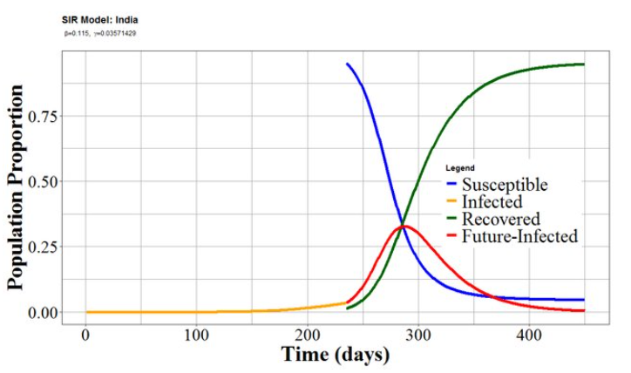
SIR MODEL OF COVID-19 OUTBREAK
The Susceptible-Infected-Recovered (SIR) model is a mathematical model used to describe the spread of a disease in a population. In this, the considered population belongs to any one of the three compartment levels: Susceptible, Infected and Recovered.
This model can be expressed by the set of time related nonlinear ordinary differential equations:
𝑑𝑆(𝑡)/𝑑𝑡 = − (𝛽𝑆(𝑡)𝐼(𝑡))/N
𝑑𝐼(𝑡)/𝑑𝑡 = (𝛽𝑆(𝑡)𝐼(𝑡))/N, −𝛾𝐼(𝑡)
𝑑𝑅(𝑡)/𝑑𝑡 = 𝛾𝐼(𝑡)
Initial conditions: S = 𝑆_{0,} I = I_{0,} R = R₀ (at t=0)
Solving the equations we get, 𝑆(𝑡) = S₀ e^{− 𝛽/𝑁𝛾(𝑅(𝑡)−𝑅}₀⁾
We can use this model for knowing the extent of the outbreak, recovery rate, etc
OBJECTIVE : This paper aims to find optimal strategies for mitigating the spread of coronavirus in India and vaccinating people. We have used a game theoretic approach in dealing with the scenario. The study consists of finding the best way of implementation of lockdown, optimal condition of compliance of individuals with the guidelines and interventions pertaining to Covid-19, and then it moves on to the vaccination game. Game Theory is used to find how individuals should make decisions pertaining to vaccination taking into account the vaccine hesitancy in India, and developing strategies relating to which age groups should be vaccinated first in order to result in a fall in death rate of people due to Covid-19.

Slide 4
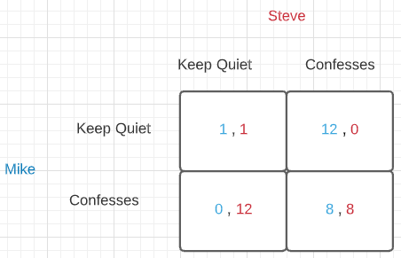
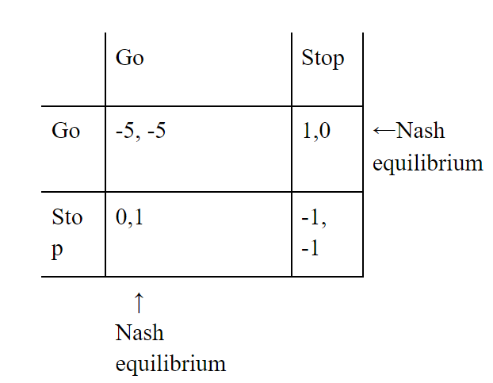
METHODOLOGY
Game Theory: It is the study of strategically interdependent behaviour i.e., what one player does affect the other player outcomes & vice versa on the basis of the set rules & includes pay-offs such as win, lose or draw.
Visual Layouts in Game Theory: Matrices & Trees
Types of Strategy: Maximax, Maximin, Minimax & Dominant Strategies
Different types of Games:
Cooperative and Non-Cooperative games
Normal form and Extensive form games
Simultaneous move games and Sequential move games
Constant Sum, Zero Sum, and Non-Zero-Sum games
Symmetric and Asymmetric games
Example-The Prisoner’s Dilemma : The prisoner’s dilemma is a scenario in which the
payoff from cooperation is larger than considering and pursuing self-interest.
Nash Equilibrium:
Nash equilibrium, named after John Nash, is a solution to a game involving two or more
players who want the best outcome for themselves and must take the actions of others into
account.

Slide 5
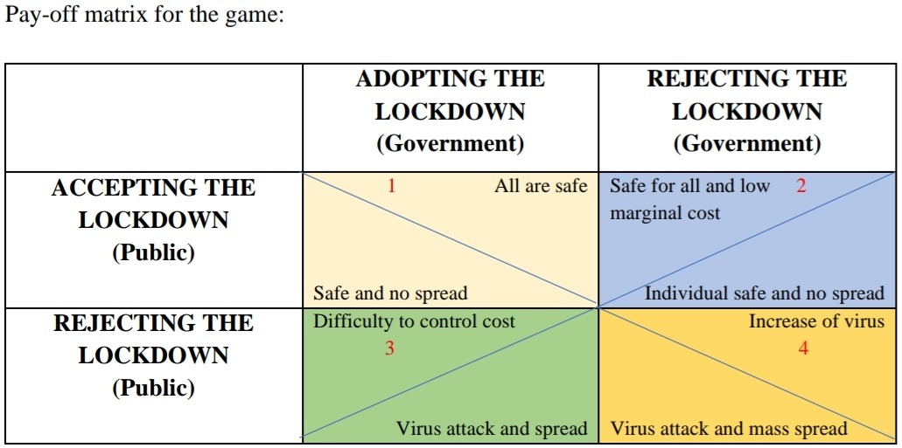
FINDING OPTIMAL STRATEGY TO MITIGATE CORONAVIRUS SPREAD IN INDIA
Understanding people as players in a game, each player having their own strategy, we will study the payoff of their strategy, each strategy having a significant impact at a community level in combating COVID-19.
Implementation of Lockdown
Here, we have to determine the economic decision which people and government should take to reduce the transmission of SARS-CoV-2 and achieve an optimal condition. For this work, lockdown is an important measure being taken to reduce the transmission and fatality rate.
The condition in Box 2 is quite desirable for both players and is the optimal solution of the game.

Slide 6
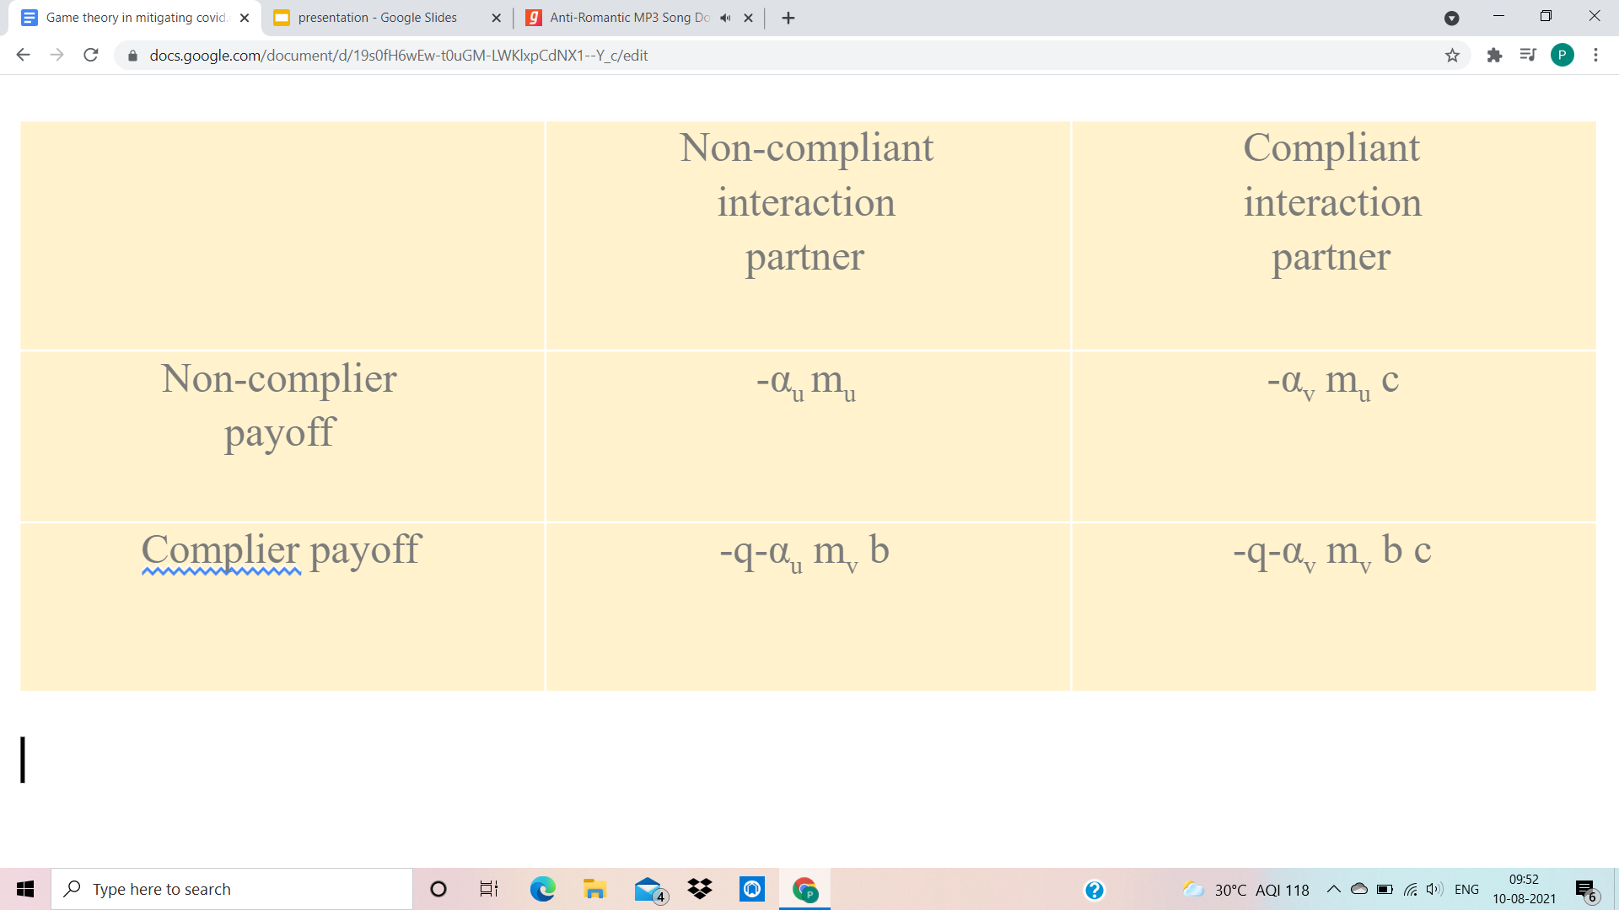
Individual Optimal Choices
Using a game theoretic framework, we have modelled the choice of people if they want to follow the ‘interventions’ or not, which compares the perceived cost of compliance in relation to perceived cost of infection to the individual. Individuals derive a benefit or cost (i.e., a payoff) from interactions with other individuals in the population, who can also either be compliers or non-compliers.
Non-compliance is a Nash equilibrium if,
I. -α_{u} m_{u}> -q-α_{u} m_{v} b
II. -α_{v} m_{u}> -q-α_{v} m_{v} b
Or equivalently,
I. α_{u} < q / (m_{u}-m_{v} b)
II. c α_{v} < q/ (m_{u}-m_{v} b)
Since, non-compliers are much more likely to be infected
than compliers.
Implies that, α_{u}> c α_{u}
Therefore, non-compliers receive a greater payoff than compliers when interest with both non-compliers is sufficient for noncompliance to be a Nash equilibrium.
The expected payoff to non-complies is greater than the payoff to compliers. Hence, the cost will be more for non compilers than compliers.

Slide 7
THE VACCINATION GAME
Vaccine Hesitancy
Vaccines, or getting vaccinated, are one of the most effective solutions in eradicating the pandemic. But there are factors such as vaccine hesitancy among the population, or who to be vaccinated first, which lead to different strategies of an individual player and hence a different payoff to him/her.
Description of Game:
All the players are provided with the same information & access this same information in considering the risks.
Let a player’s strategy is the probability P that he/she will choose to vaccinate. The vaccine uptake level in the population is the proportion of all the eligible players who will be vaccinated .
Notations:
rᵥ = morbidity risks from vaccination
rᵢ = morbidity risks from infection
ℼₚ = probability that an unvaccinated player will eventually be
infected if vaccine coverage level is ‘p’ in the population
Payoff to vaccinated player = - rᵥ
Payoff to unvaccinated player = - rᵢ ℼₚ
Thus, strategy of vaccinating with probability P yield expected payoff
E (P, p) = P (- rᵥ) + (1 - P) (- rᵢ ℼₚ)

Slide 8
Characterization of Nash Equilibrium:
P will always give a higher payoff than Q and is said to be a nash equilibrium.
In contrast, if most of the players adopt strategy Q, but the players adopting a strategy which is closer than Q to P, obtain a higher payoff than those adopting Q, and if it is for any Q ≠ P, then P is said to be convergently stable.
If P is a Nash equilibrium, & every player currently playing P, then no one should change strategy.
If P is convergently stable, then no matter which strategy is most common, one should start to play strategies closer to P, & ultimately adopt P.
Suppose that a proportion ε of the population vaccinates with probability P and the remainder vaccinates with probability Q.
We can write, p = ℇP + (1-ℇ)Q
Payoff to individuals playing P: Eₚ(P,Q, ℇ) = E(P, ℇP + (1-ℇ)Q)
payoff to individuals playing Q is: E_{q}(P,Q, ℇ) = E(Q, ℇP + (1-ℇ)Q)
The payoff gain to an individual playing P in such a population is: ∆E= E_{P}-E_{Q}=[π_{ℇP+(1-ℇ)Q} – r](P-Q)
If the vaccine is perceived to be sufficiently risky (r ≥ π0) then the CSNE is “never vaccinate” (P* = 0). In contrast, if r < π0, then the CSNE is “vaccinate with nonzero probability P*” (0 <P*< 1). In the latter case, the CSNE is said to be mixed (as opposed to the pure strategies P = 0 and P = 1).

Slide 9
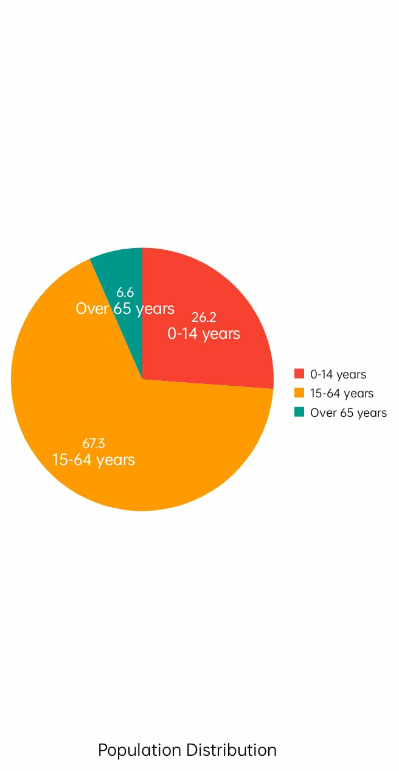
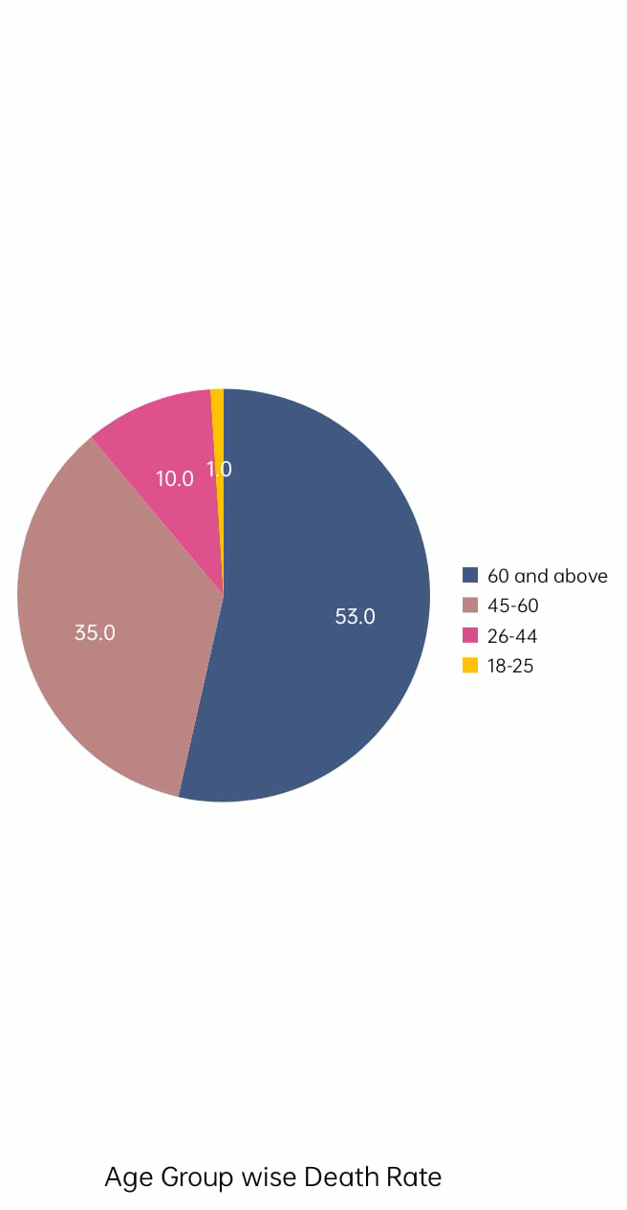
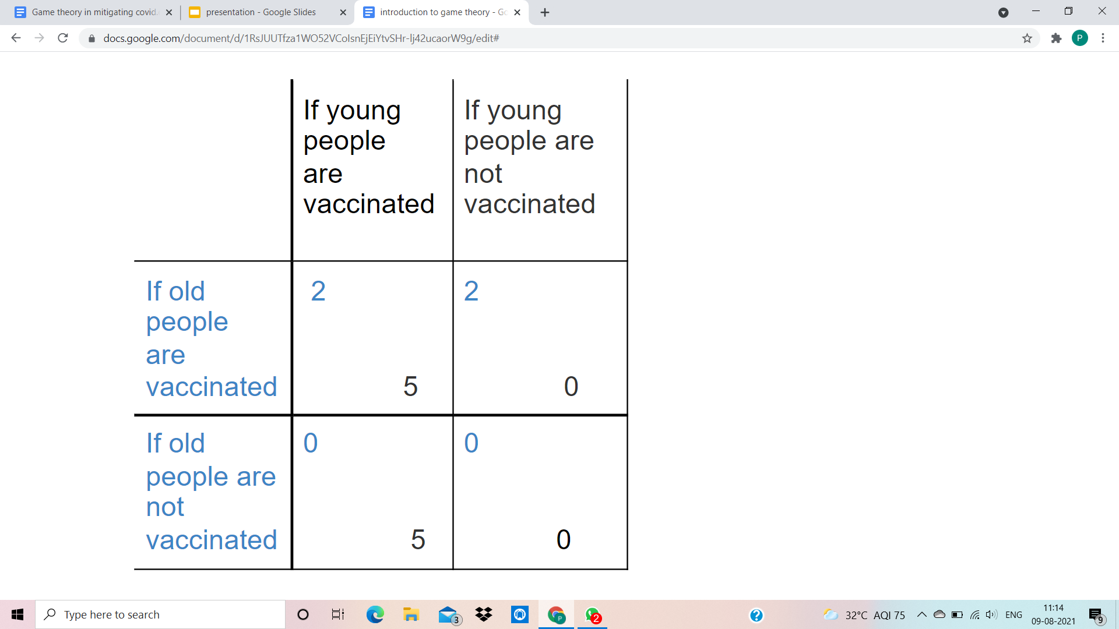
Vaccination on the basis of age group
Given the limited availability of vaccines at the initial stages, effective prioritization and optimal use of resources are crucial. Prioritization should be based on targeting individuals, cities or states that can act as critical nodes of transmission or super spreaders.
Currently the population of India is around 136.64 crores. According to the report, about 53% of the victims who died due to covid . aged 60 years and above
This data clearly shows that the young people and those above 60 years with comorbidities
should be in the priority is group for the vaccination.
Reasons:
1. People with comorbidities have less immunity prior to the viral infection due to other diseases
so they are more likely to be susceptible to infection and less likely to survive.
2. Although only 45% of the young people in the 26 to 60 age group have succumbed to the
infection. They constitute a major part of the total population and hence are more likely to
increase the infection rate even exponentially if their socialization is minimized and also, they are
equally responsible for the country's herd immunity as well.

Slide 10
CONCLUSION
Comprehensively, the study shows that to mitigate the spread of COVID-19, it is imperative to follow certain guidelines and have effective vaccination strategies. With respect to implementation of lockdown, the optimum strategy is when government has to spend the least amount on implementing the strategy but the public still follows the proper measure resulting in mitigating the transmission of the virus in the most effective way. Moreover, individuals should follow up to the interventions- masks, sanitisation, et cetera to minimise costs. In relation to vaccination, it is crucial that people overcome vaccine hesitancy, and for the government it is important to vaccinate the people above age group 60 so that the death toll decreases.
THANK YOU

